Slide 1


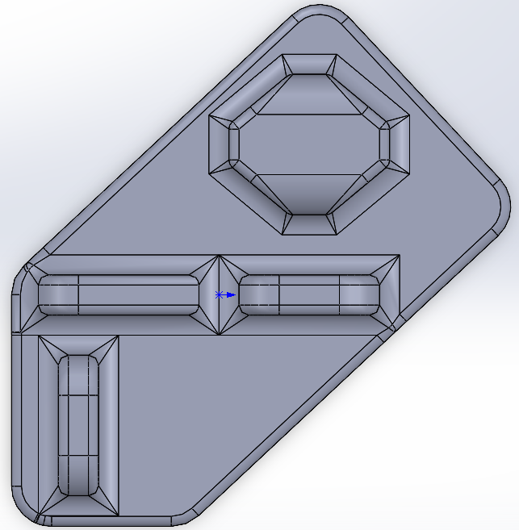
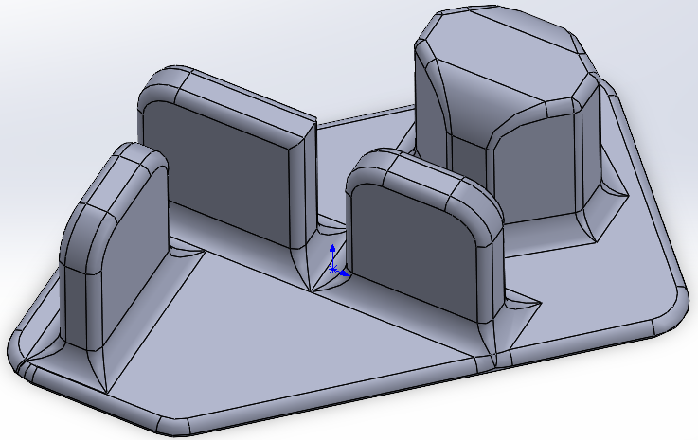
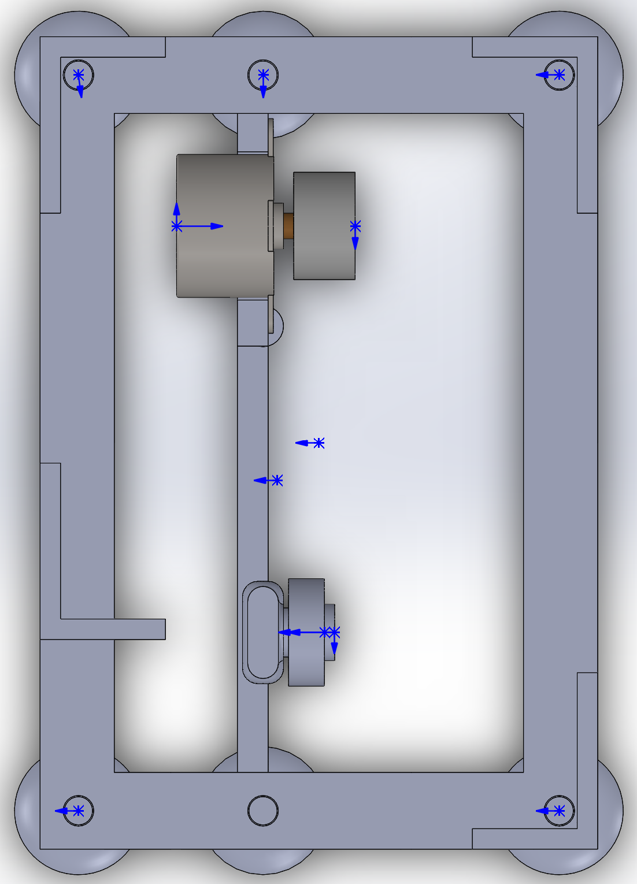
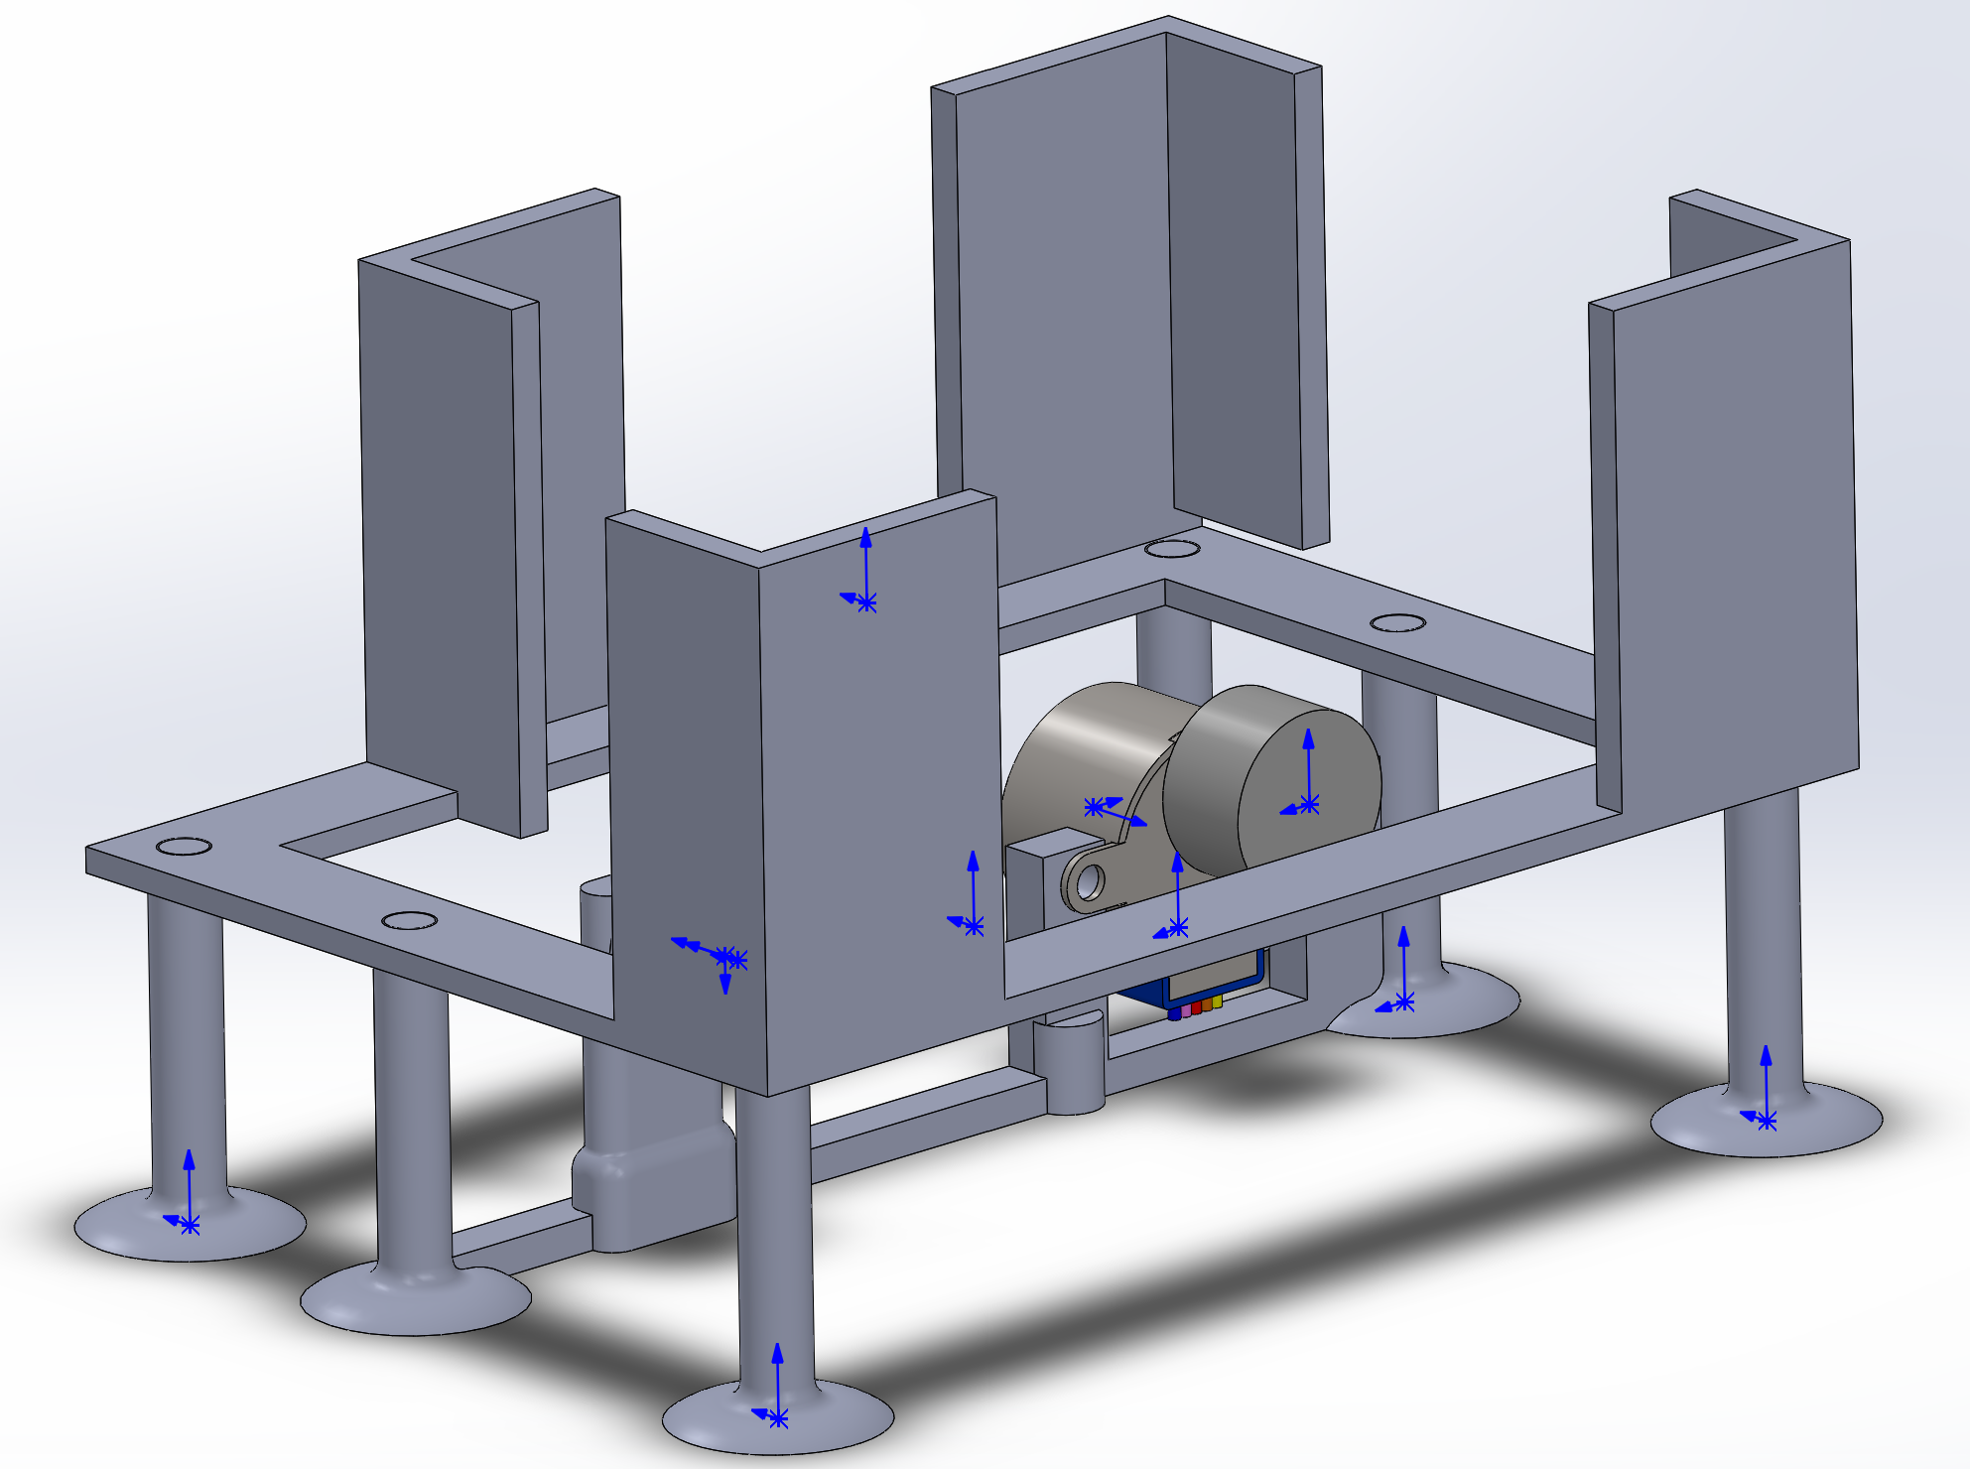
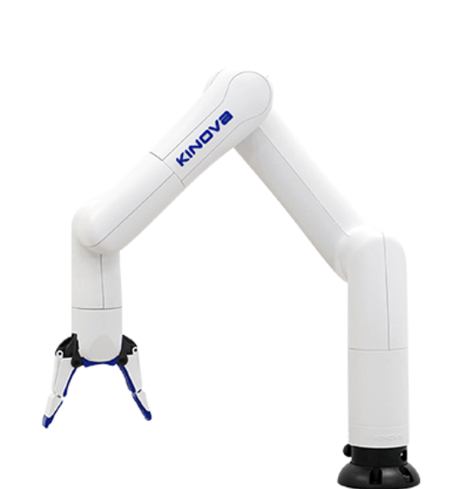
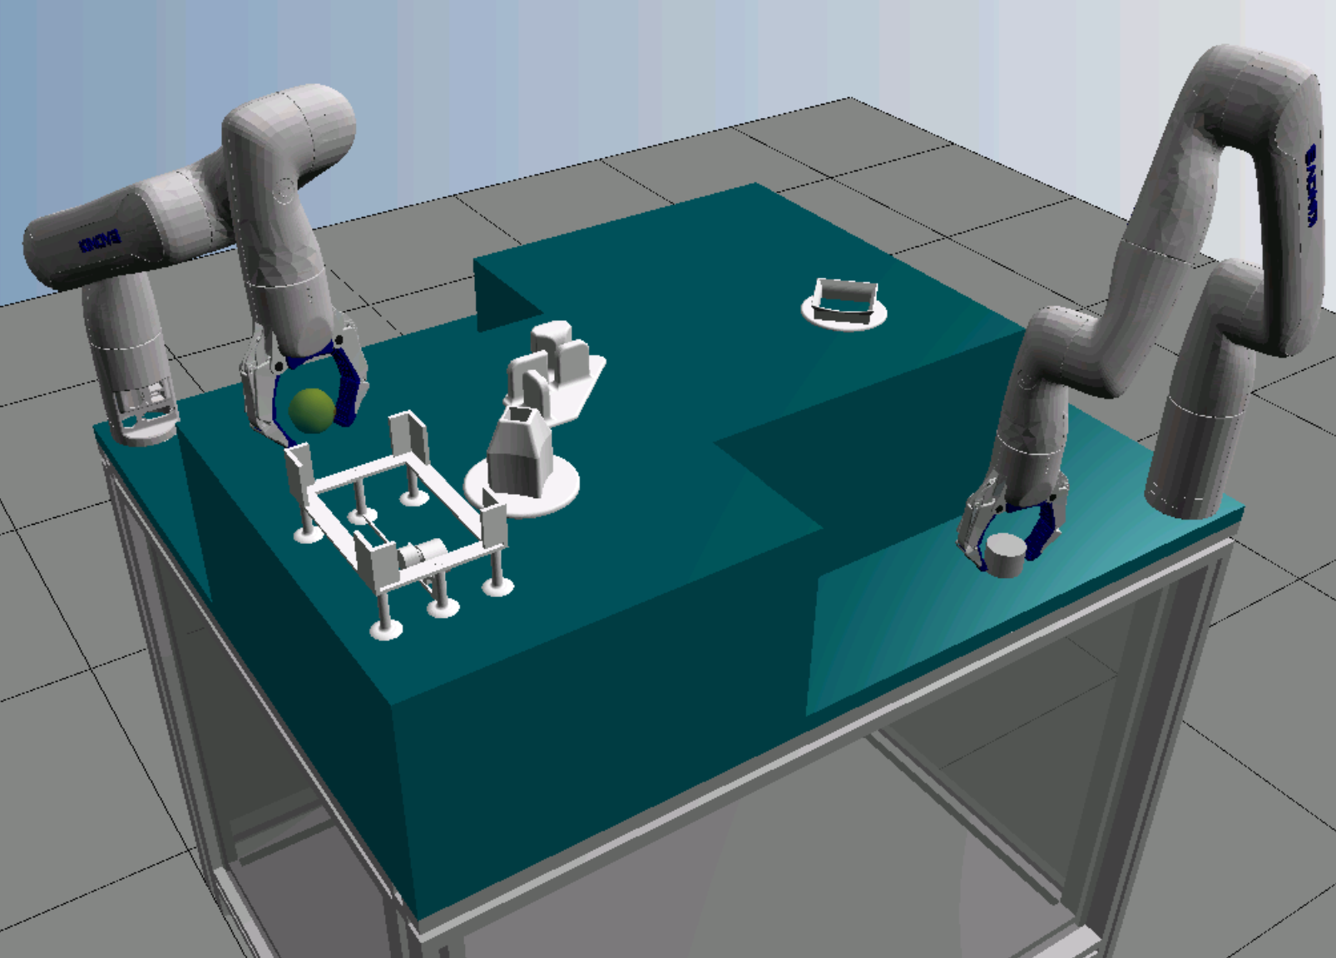
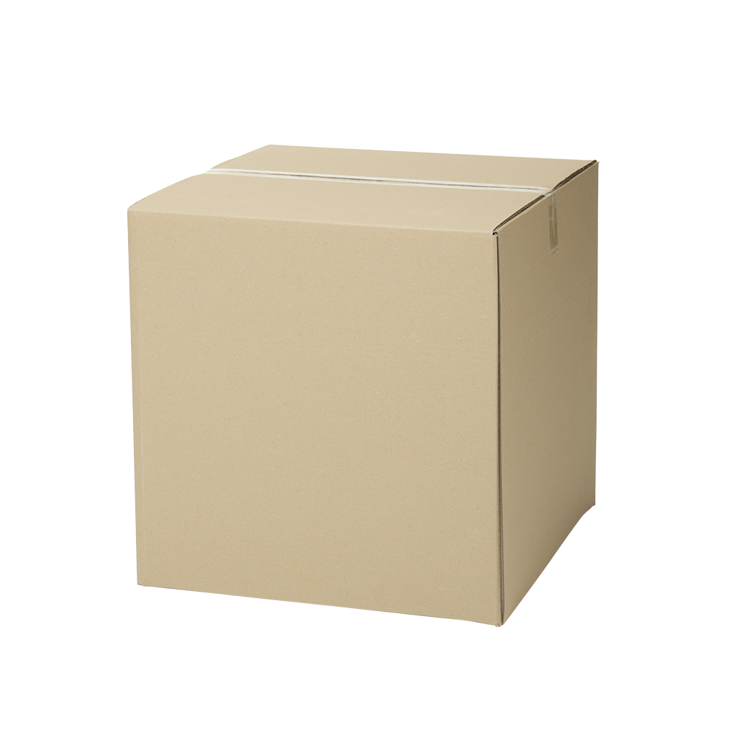
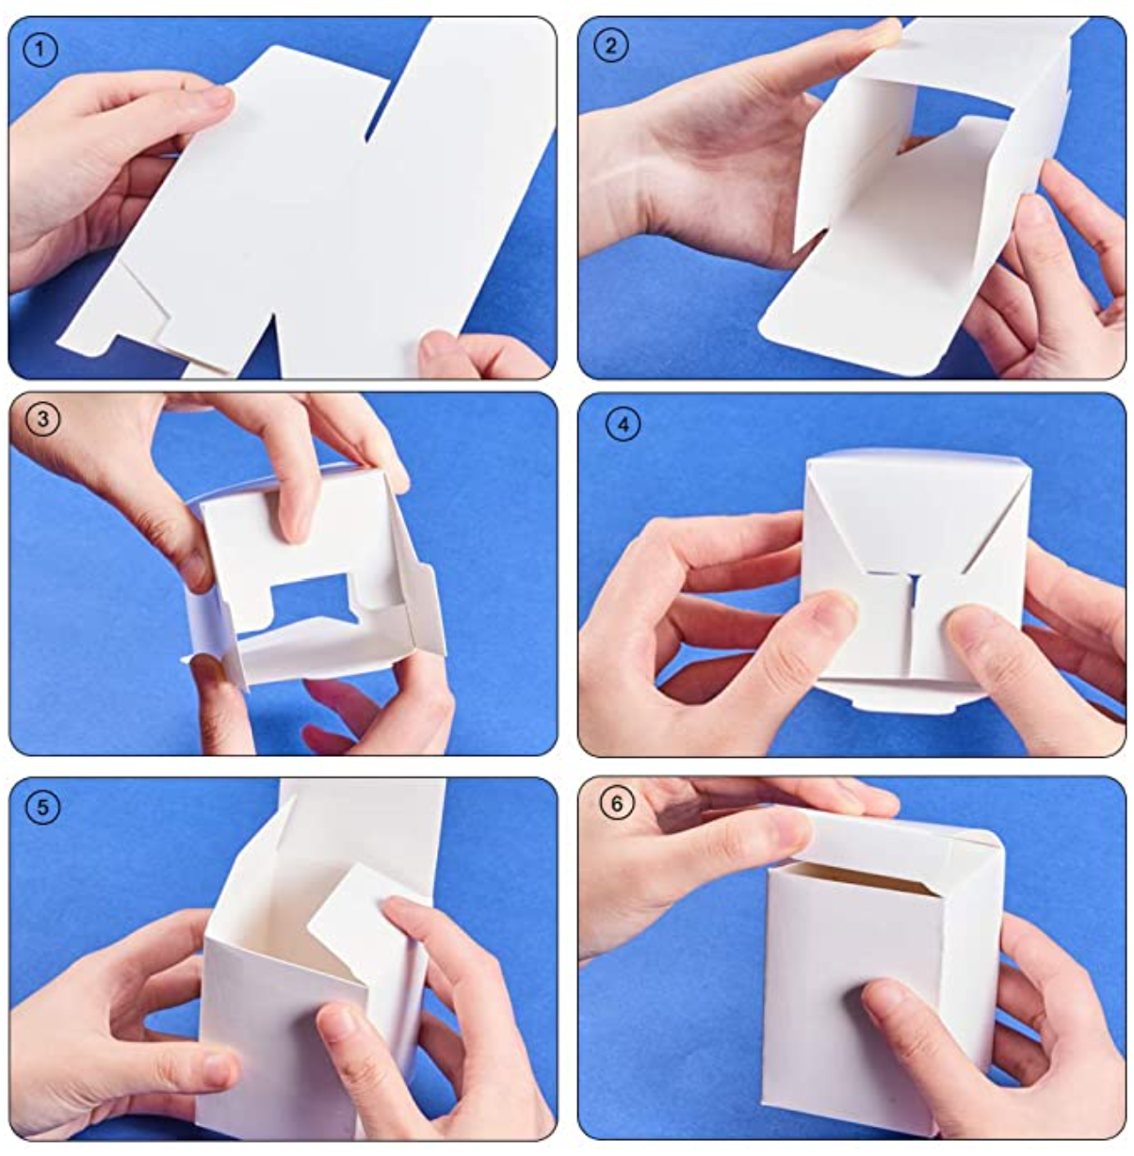
Automated Packaging using Collaborative Robots
Ben Ellis, Ethan Gibbard, Zach Kelly, Kade Ronneberg, Qianyi Wang
Faculty Advisor: Dean Richert Project Partner: UBC
Group #62
Introduction
Automation has proven to be a desirable solution existing in the manufacturing industry. We were tasked with developing a way to reduce the need for physical labour in a packaging facility while maximizing modularity to align with the concept of cellular manufacturing. While first tested and designed for use in the manufacturing line at UBCO, the end goal of this project is to develop a modular unit to package objects from a generic assembly line.
The current stage of this project is to expand the university’s pre-existing FESTO lineup into a small-scale manufacturing process while providing a new framework for developing automation technology. The extended manufacturing process consists of packaging the workpieces from the FESTO lineup inside of a cardboard box.
The packaging procedure is as follows:
The cardboard flat packs are manually inserted inside the storage/dispensing unit and ejected individually via a drive belt that is powered by a stepper motor
The flat pack is pulled out of the dispenser and opened with the Kinova gripper
The opened box is placed on the re-gripper column
The Kinova arm then re-grips and passes through the fin mechanism to fold the bottom flaps of the box
The folded bottom is placed is positioned in cardboard box support
The secondary Kinova arm then grabs the assembly from the FESTO lineup and places it in the box
The Kinova arm folds the top flaps and places the completed package at the end of the manufacturing line.
Figure 6. Cost of manual packaging vs
robot packaging
Materials and Methods
The current model consists of numerous integrated designs to assist the manufacturing process, due to the absence of sensory feedback and the limitations of the Kinova Gen3Lite.
The system includes the following components to improve operational performance:
3D printed storage and dispensing unit, including a stepper motor and reflectivity sensor.
3D printed re-gripper column.
3D printed folding mechanism.
3D printed box support/positioner.
Elevated platform
As previously mentioned, the current model is only capable of semi-consistent packaging. This is primarily due to the following issues:
Sensitivity to the environment
Robustness of equipment
Future Work
The system’s high sensitivity to the environment attributes to its ability to perceive and evaluate its surroundings. The considered solution is the implementation of a visual module, such as the cameras of the Intel® RealSenseTM Depth Module D400 series. Visual sensing opens the doors to simultaneous localization and mapping, which ultimately allows the system to operate in unknown or disturbed environments.
Improving the robustness of equipment used in the process suppresses the occurrence of disturbances to the system. This comes with a cost, however, improves the performance and reliability of the packaging process.
Figure 4. Folding Mechanism
Results
A semi-consistent packaging process has been obtained utilizing the method mentioned above. A program written in Python is used to control the Kinova motion. Prior to running the program for the first time the movements are actuated by an Xbox controller and recorded as a sequence of coordinate inputs to the program. The program takes this array of inputs and maps between the coordinates to replicate the robots’ motion. In order to improve packaging time, the program holds queue of the current stage for each Kinova, as well as the stage to progress to after specific positions. The script will not process a step unless both robots have progressed to the stage required. This allows the two robots to synchronize what tasks can be completed in parallel, and which movements require the completion of tasks by the other robot. Working in parallel removes the inefficiency of having only one robot working at any given time, effectively increasing efficiency close to 50%.
Conclusions
In the current state of the project micro-adjustments often need to be made, otherwise certain critical stages of the folding process will be missed. With the suggested improvements implemented, the future of this project becomes more economically favourable against manual labour and furthers the development of modular, automated packaging.
Figure 1. Flatpack Dispenser
The entire packaging procedure has been simulated in a virtual learning environment, CIROS Studio. The simulation is achieved by setting workstations, programming robots and modifying robot positions, and analyzing the gauge and bend of folding cardboard.
The packaging process is completed via two diagonally mounted Kinova Gen3Lite Robots and the integrated designs mentioned above. The Kinova robots are equipped with parallel motion two-jawed grippers and controlled via python.
References
L. Rozo, S. Calinon, D. G. Caldwell, P. Jiménez and C. Torras, "Learning Physics Collaborative Robot Behaviors From Human Demonstrations," in IEEE Transactions on Robotics, vol. 32, no. 3, pp. 513-527, June 2016, doi: 10.1109/TRO.2016.2540623.
M. Kwon, E. Biyik, A. Talati, K. Bhasin, D. P. Losey, and D. Sadigh, (2020), “When Humans Aren't Optimal: Robots that Collaborate with Risk-Aware Humans”, In Proceedings of the 2020 ACM/IEEE International Conference on Human-Robot Interaction (HRI '20). Association for Computing Machinery, New York, NY, USA, 43–52.
Kinova GEN3 Lite compact robotic arm for education. Kinova. (n.d.). Retrieved November 19, 2021, from https://www.kinovarobotics.com/en/products/gen3-lite-robot.
BENECREATE. (2018, December 13). BENECREAT 60PCS Gift Boxes White Paper Boxes Party Favor Boxes 2 x 2 x 2 Inches with Lids for Gift Wrapping, Wedding Party Favors [web log]. Retrieved November 19, 2021.
Bulanon, D. M., Burr, C., DeVlieg, M., Braddock, T., & Allen, B. (2021). Development of a Visual Servo System for Robotic Fruit Harvesting. AgriEngineering, 3(4), 840–852. doi:10.3390/agriengineering3040053
Figure 2. Kinova Gen3 Lite Robot
Figure 5. CIROS simulation environment
The graph in Figure 6. shows the relationship between the upfront operational cost, versus the amount of products needed to be packaged yearly, of a robotic packaging station versus manually packaging products. Due to the high upfront cost of the robots, it will take just over a year for a fully utilized packaging station to economically outperform manual labour. The operational cost of a fully utilized packaging station would be $62.76, compared to the manual cost to package the same amount of products of $32,850.
Acknowledgments
We thank Dr. Dean Richert, Ram Dershan, and the faculty of Engineering at UBCO for their support and resources towards the creation of this project.
For further information Contact:
Ben Ellis, Team Lead
Email : b.ellis@live.ca
Figure 3. 2x2x2 Flatpack and Folding method

